Slide 1
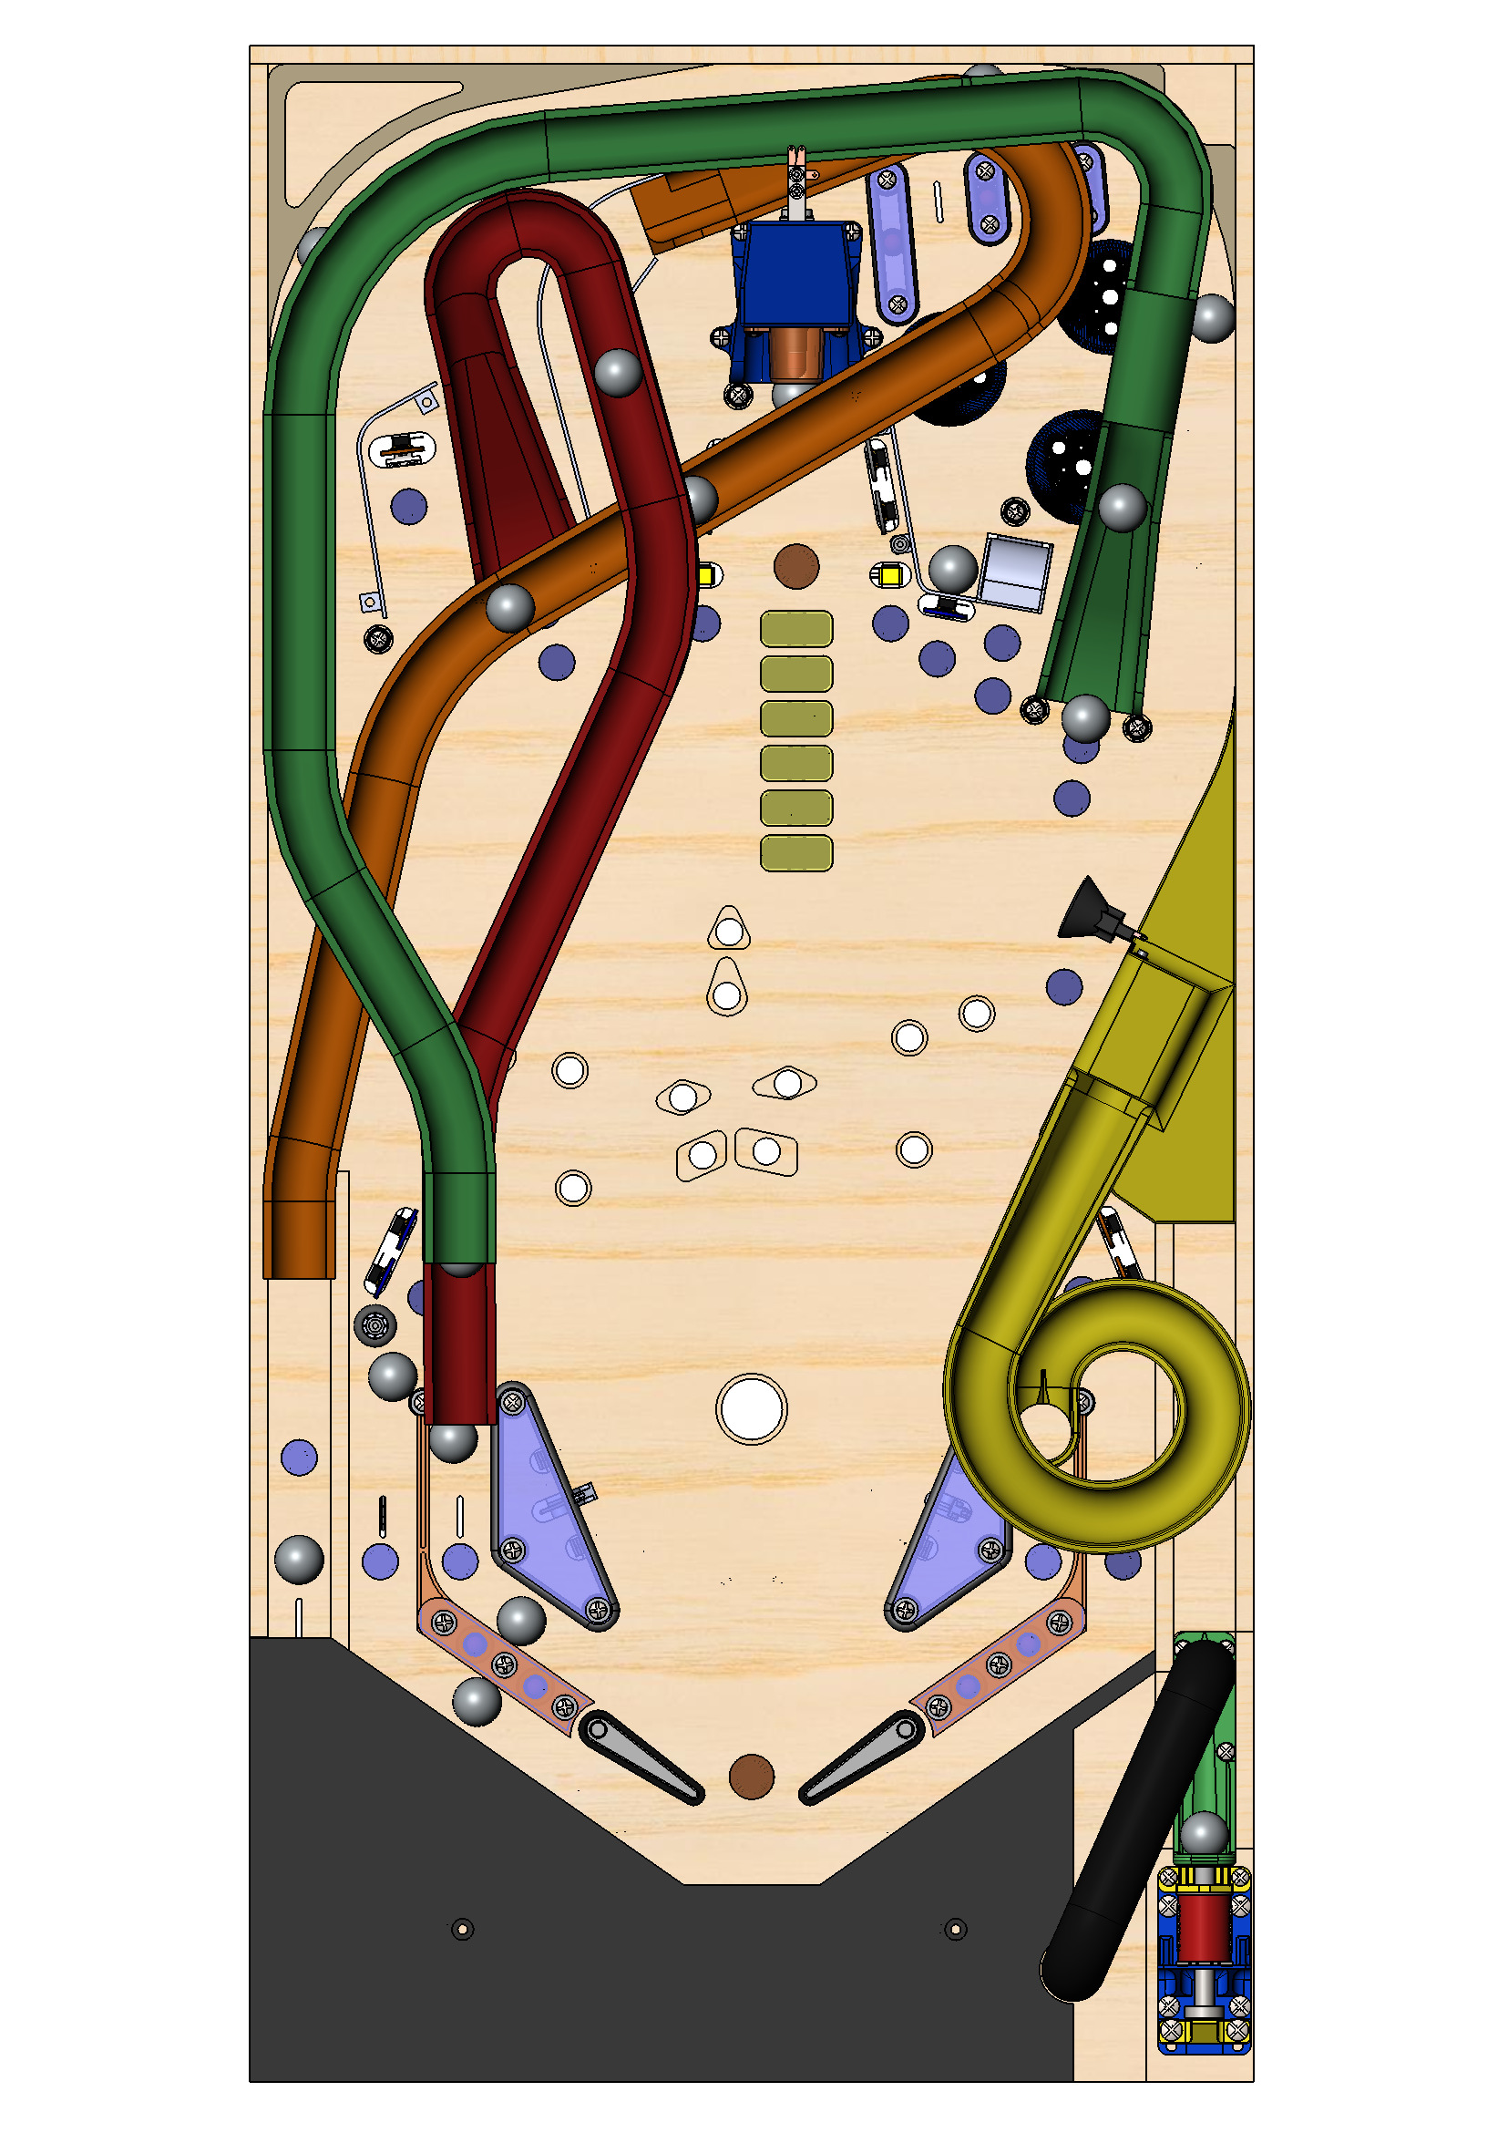
Goldorak Go switch
s_left_door
1-0-58
s_right_door
1-0-59
s_right_ramp2
1-0-52
s_left_highline
1-0-56
s_right_highline
1-0-57
s_central_ramp_target
1-0-55
s_high_bumper
1-0-45
s_falling_target
1-0-74
s_left_bumper
1-0-43
s_left_high_target
1-0-66
s_central_target2
1-0-71
s_central_target4
1-0-73
s_down_bumper
1-0-44
s_central_target1
1-0-70
s_central_target3
1-0-72
s_left_ramp2
1-0-54
s_middle_target1
1-0-68
s_middle_target2
1-0-69
s_right_high_target
1-0-67
s_cave
1-0-75
s_left_ramp1
1-0-53
s_hidden_target 1-0-61
s_catapult_spinner
1-0-60
s_left_target1
1-0-62
s_right_target1
1-0-64
s_left_target2
1-0-63
s_right_target2
1-0-65
s_right_ramp1
1-0-51
s_left_outlane
1-0-47
s_left_inlane
1-0-48
s_left_slingshot
1-0-41
s_right_slingshot
1-0-42
s_right_inlane
1-0-50
s_right_outlane
1-0-49
s_catapult
1-0-46
s_plunger_lane
1-0-40
s_flipper_left
1-0-32
s_flipper_right
1-0-33
s_trough2
1-0-35
s_trough1
1-0-34
s_trough3
1-0-36
s_trough4
1-0-37
s_start_button
1-0-39
s_plunger
1-0-38

Slide 2
Goldorak Go coils
c_high_bumper
1-0-10
c_left_bumper
1-0-8
c_falling_target
1-0-12
c_down_bumper
1-0-9
c_cave
1-0-11
c_left_slingshot
1-0-6
c_right_slingshot
1-0-7
c_catapult
1-0-13
c_flipper_left_main
1-0-0
c_flipper_right_main
1-0-2
c_flipper_left_hold
1-01
c_flipper_right_hold
1-0-3
c_plunger_eject
1-0-5
c_trough_eject
1-0-4

Slide 3
Goldorak Go lights
l_left_highline 2-0-61
l_right_highline 2-0-62
l_central_ramp 2-0-54
l_left_high_target 2-0-46
l_left_ramp2a 2-0-57
l_falling_target 2-0-43
l_left_ramp1a 2-0-55
l_left_ramp2b 2-0-58
l_mission1 2-0-37
l_cavea 2-0-52
l_left_orbit1 2-0-59
l_left_ramp1b 2-0-56
l_middle_target1 2-0-44
l_mission2 2-0-38
l_middle_target2 2-0-45
l_caveb 2-0-53
l_left_orbit2 2-0-60
l_mission3 2-0-39
l_right_high_target 2-0-47
l_right_ramp2a 2-0-50
l_right_orbit1 2-0-61
l_mission4 2-0-40
l_right_ramp2b 2-0-51
l_right_orbit2 2-0-62
l_mission5 2-0-41
l_mission6 2-0-42
l_top_corn1 2-0-31
l_playfield1 2-0-23
l_top_corn2 2-0-32
l_right_corn1 2-0-28
l_hidden_target 2-0-24
l_left_corn1 2-0-25
l_left_corn2 2-0-26
l_right_corn2 2-0-29
l_left_eye 2-0-33
l_right_eye 2-0-34
l_vega_saucers 2-0-35
l_right_mouth 2-0-36
l_right_corn3 2-0-30
l_left_corn3 2-0-27
l_right_ramp1a 2-0-48
l_left_target1 2-0-20
l_right_target1 2-0-22
l_left_target2 2-0-21
l_right_ramp1b 2-0-49
l_right_target2 2-0-23
l_catapult 2-0-17
l_left_slingshot1 2-0-9
l_final_battle 2-0-19
l_right_slingshot1 2-0-15
l_left_outline 2-0-5
l_left_inline 2-0-6
l_left_slingshot2 2-0-10
l_right_slingshot2 2-0-16
l_right_inline 2-0-12
l_right_outline 2-0-11
l_left_guide1 2-0-7
l_right_guide1 2-0-13
l_left_guide 2-0-8
l_right_guide2 2-0-14
l_shoot_again 2-0-18
l_plunger_lane 2-0-4
l_left_flipper 2-0-2
l_right_flipper2-0-3
l_start 2-0-1
l_plunger 2-0-0

